Slide 2
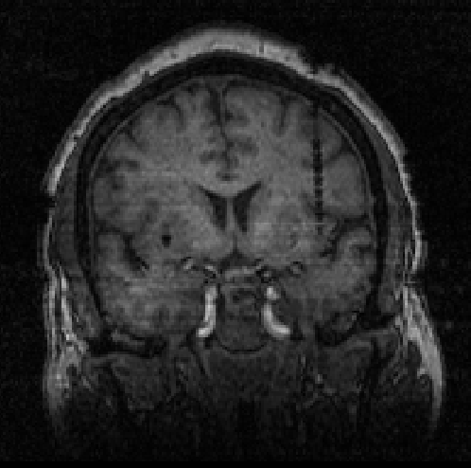
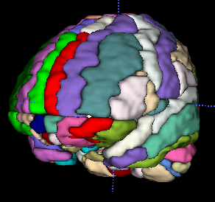
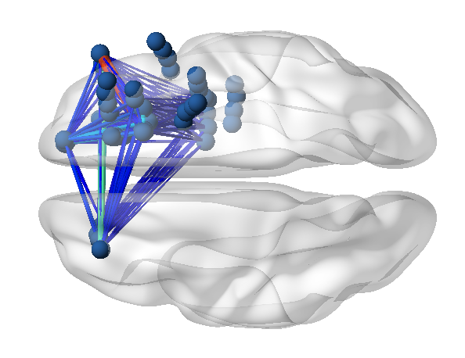
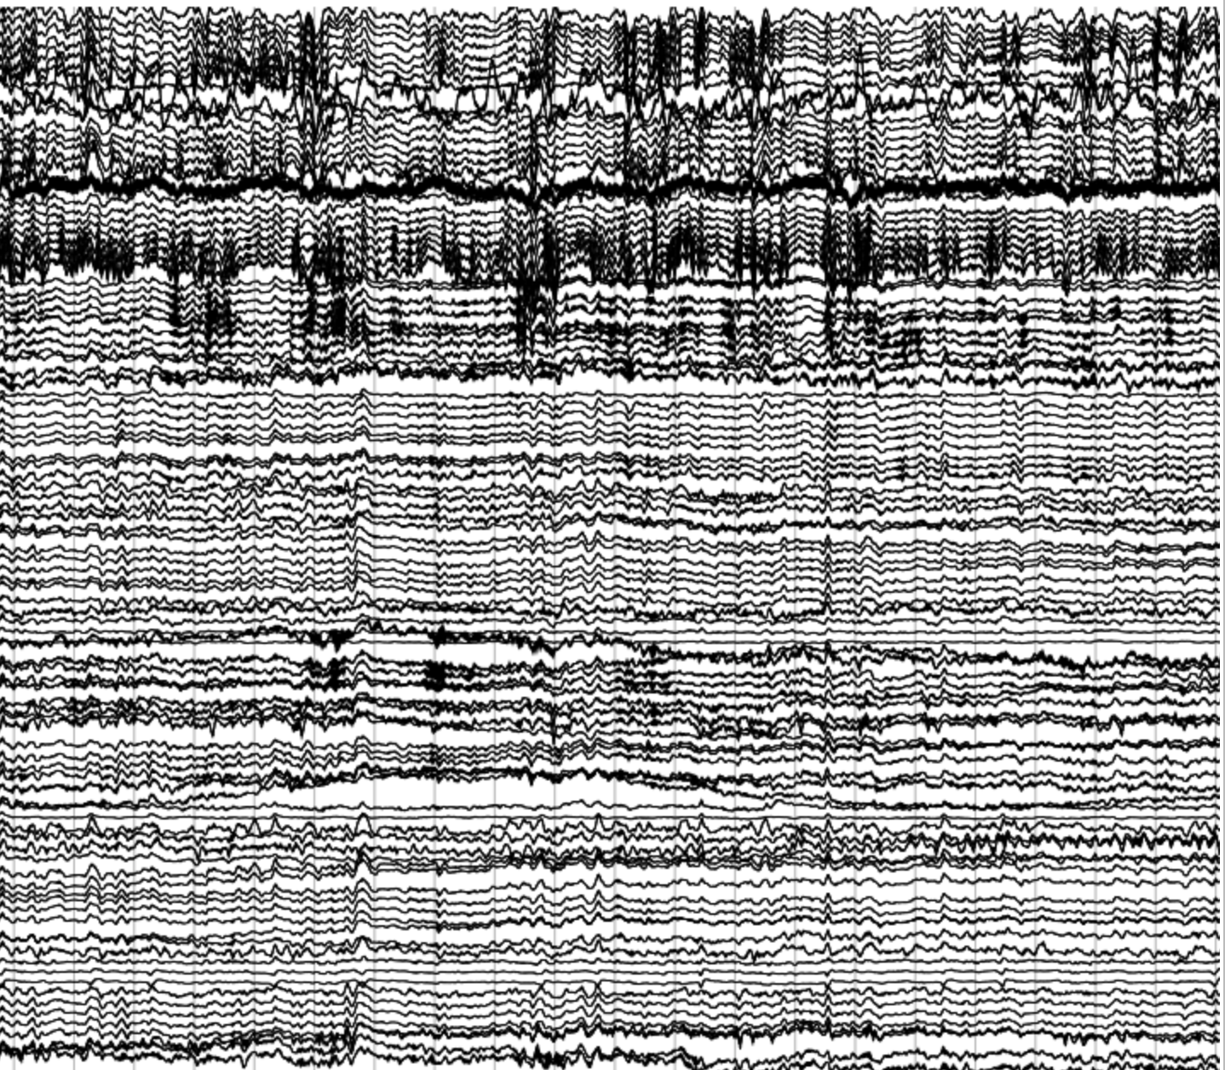
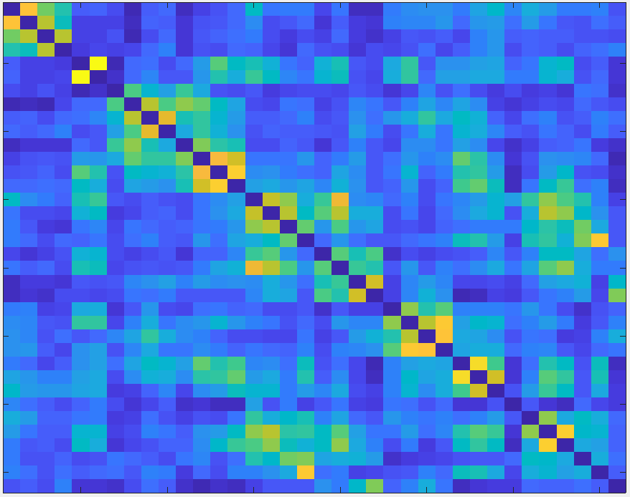
Figure 1
A
Electrode | Brain ROI | X | Y | Z
LA1 | Amygdala | -29.14 | 27.42 | -21.65
LA2 | Amygdala | -30.74 | 22.79 | -21.45
LA3 | White Matter | -32.92 | 17.69 | -21.10
… | … | … | … | …
RK10 | Right OpIFG | 51.35 | 21.80 | 32.37
B
Channels
Channels
Time
Channels

Slide 3
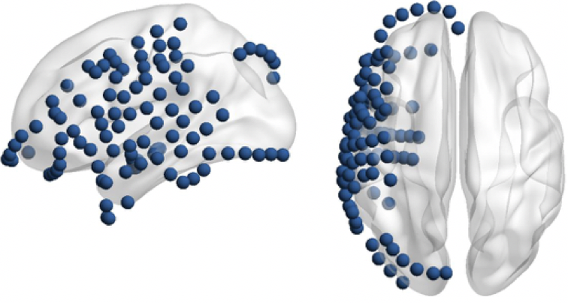
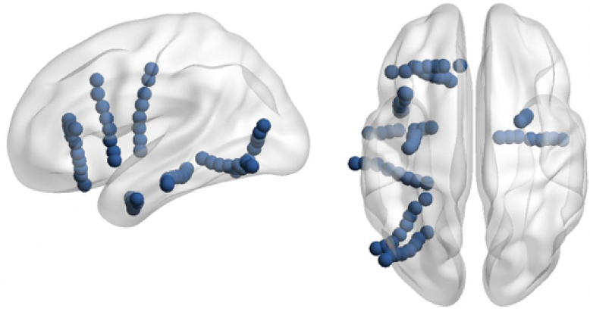
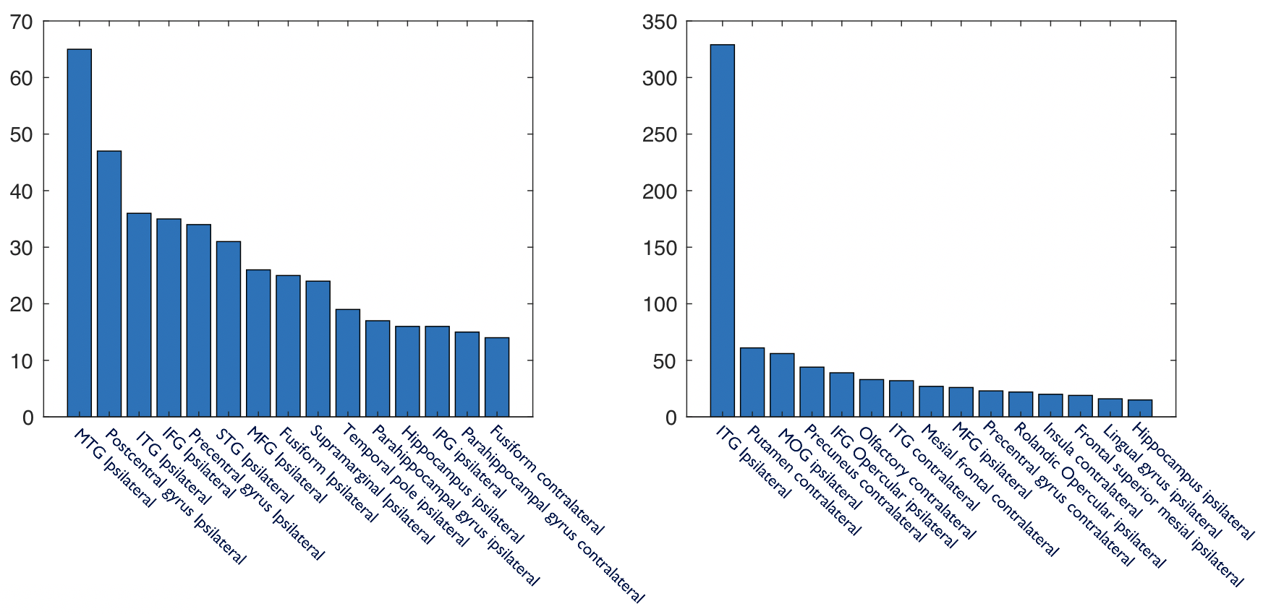
Figure 2
A
ECoG
SEEG
B
C
Mean = 65.9
Skewness = 0.36
Mean = 72.4
Skewness = 0.06

Slide 4
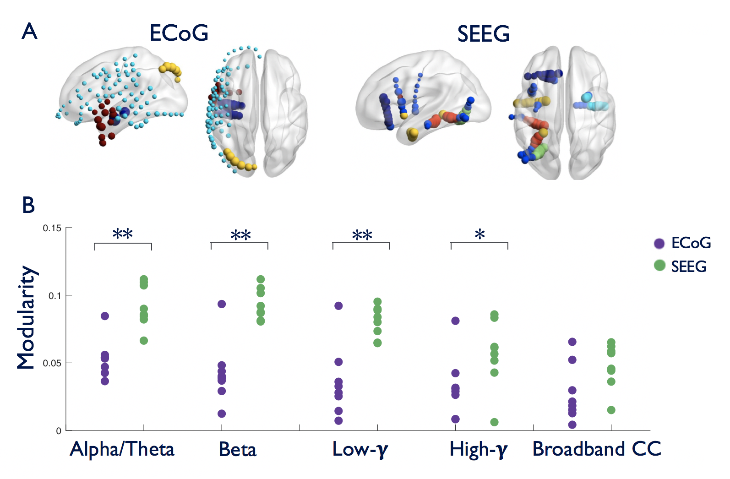
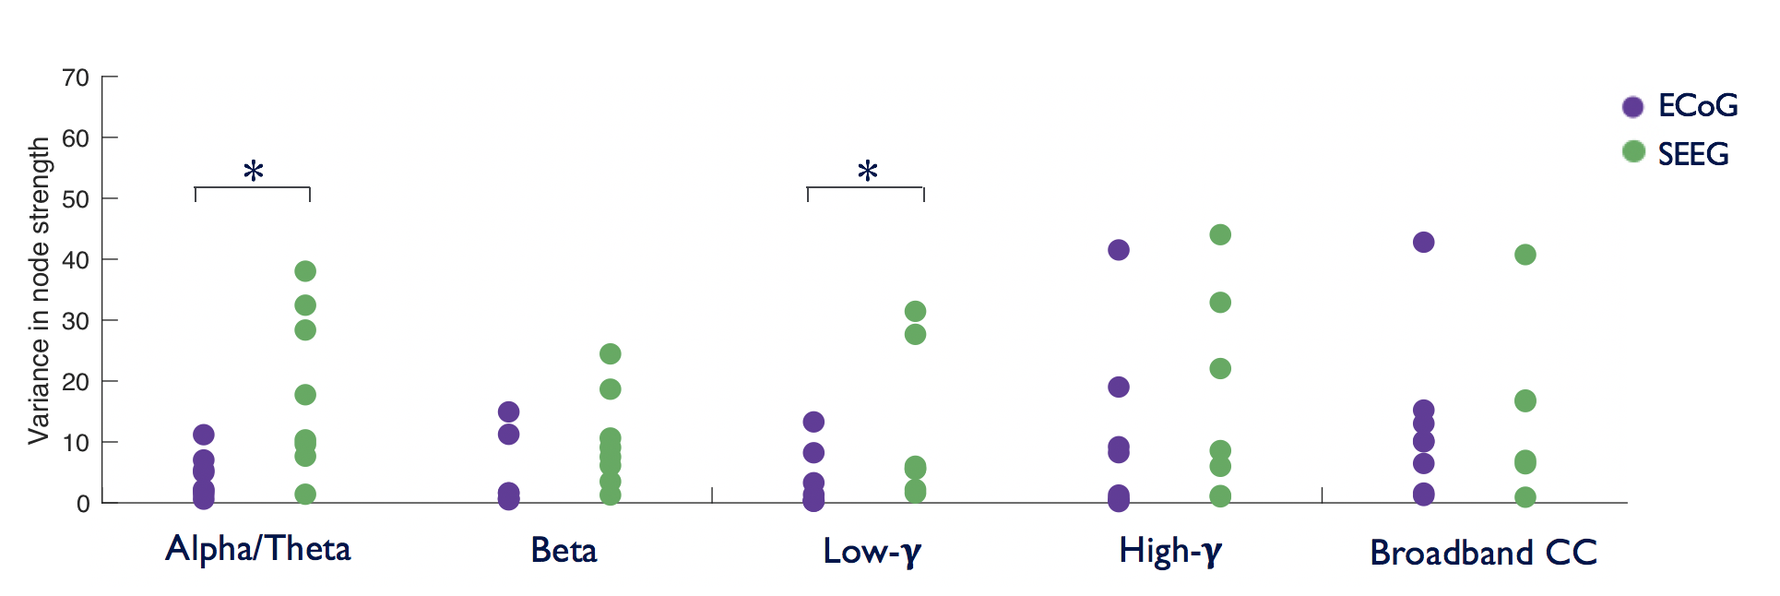
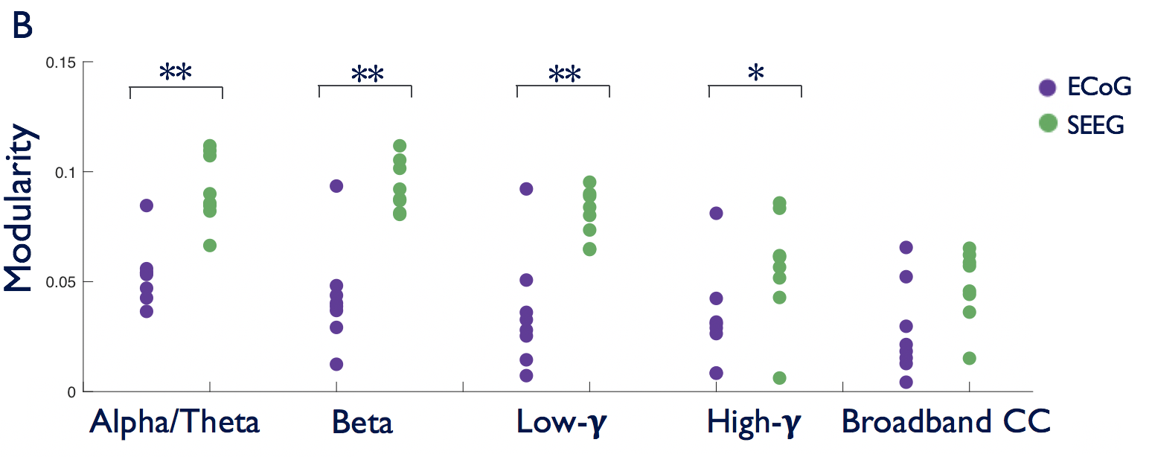
Figure 3
A
ECoG
SEEG
B
Alpha/Theta
C
High-𝛄
D
Broadband CC

Slide 5
A
Mean = 65.9
Skew = 0.36
Mean = 72.4
Skew = 0.06
B
C
D

Slide 6
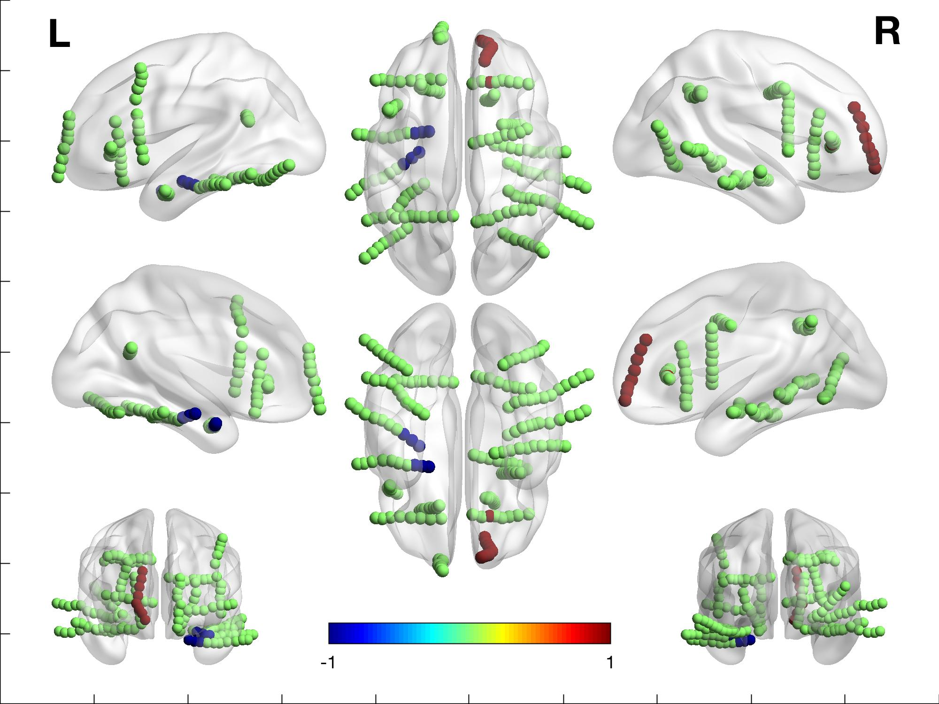


Figure 4
A
C
Calculate total node strength removed
Determine possible spatially constrained surgeries
Dice score of potential targets with actual targets
Putamen
IFG orbital
WM
SFG orbital
MTG
Insula
AC
IFG opercular
MFG
B
D
IFG triangular
Dice score

Slide 7
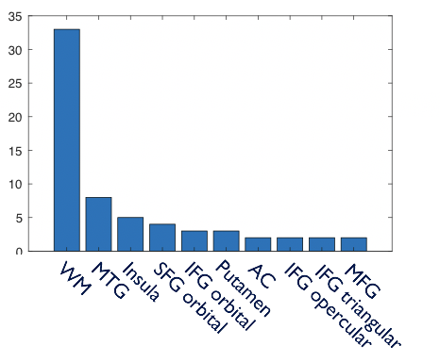
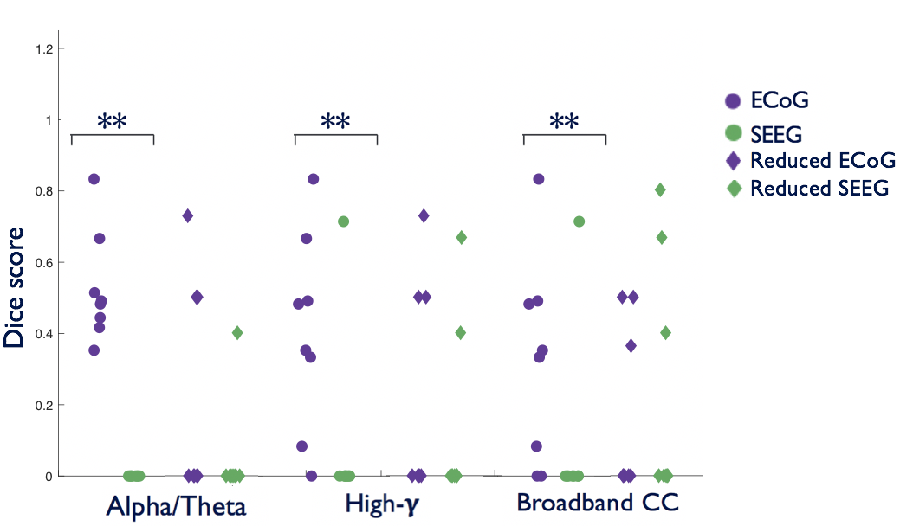
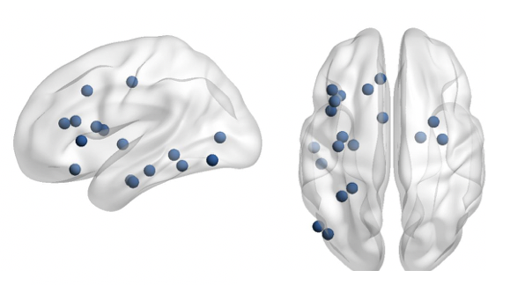
A
C
Calculate total node strength removed
Determine possible spatially constrained surgeries
Dice score of potential targets with actual targets
B
D
‘Reduced’ networks

Slide 8
Reduced ECoG
Reduced SEEG
Dice score

Slide 9
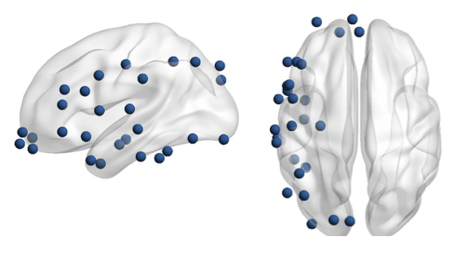
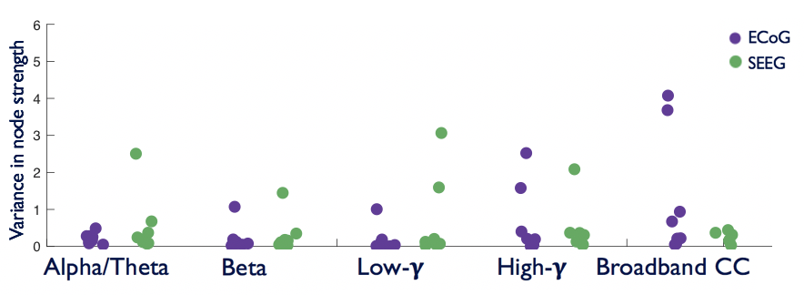
Figure 5
A
ECoG
SEEG
D
ECoG
SEEG
Alpha/Theta
B
High-𝛄
C
Broadband CC

Slide 10
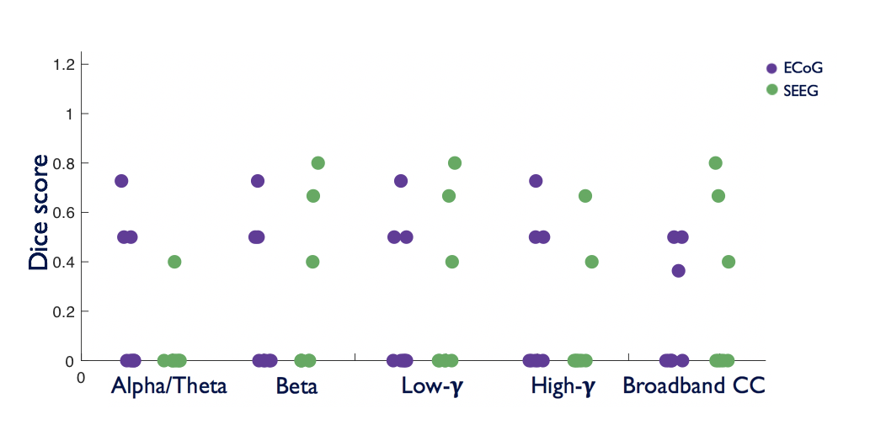
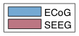
Figure 6
D
Small - Worldness
1.1
*
1
0.9
0.8
0.7
Mean small-world propensity
0.6
0.5
Dice score
0.4
0.3
Broadband
Beta

Slide 11
IFG Ipsilateral
MFG Ipsilateral
ITG Ipsilateral
ITG contralateral
MTG Ipsilateral
STG Ipsilateral
MOG ipsilateral
ITG Ipsilateral
Fusiform Ipsilateral
Olfactory contralateral
Temporal pole ipsilateral
MFG ipsilateral
Supramarginal Ipsilateral
Precuneus contralateral
Mesial frontal contralateral
IFG Opercular ipsilateral
Precentral gyrus contralateral
Precentral gyrus Ipsilateral
Putamen contralateral
Postcentral gyrus Ipsilateral
Rolandic Opercular ipsilateral
Parahippocampal gyrus ipsilateral
Insula contralateral
Hippocampus ipsilateral
Hippocampus ipsilateral
Frontal superior mesial ipsilateral
Fusiform contralateral
Lingual gyrus ipsilateral
Parahippocampal gyrus contralateral
IPG ipsilateral

Slide 12
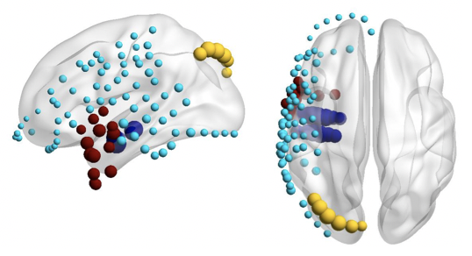
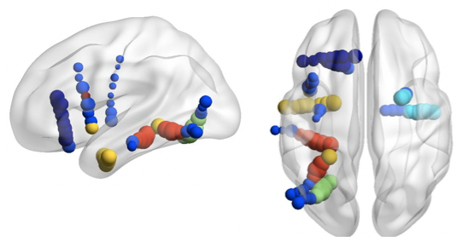
Figure 3
A
ECoG
SEEG
B
**
**
**
*
ECoG
SEEG
Modularity
Alpha/Theta
Beta
Low-𝛄
High-𝛄
Broadband CC

Slide 13
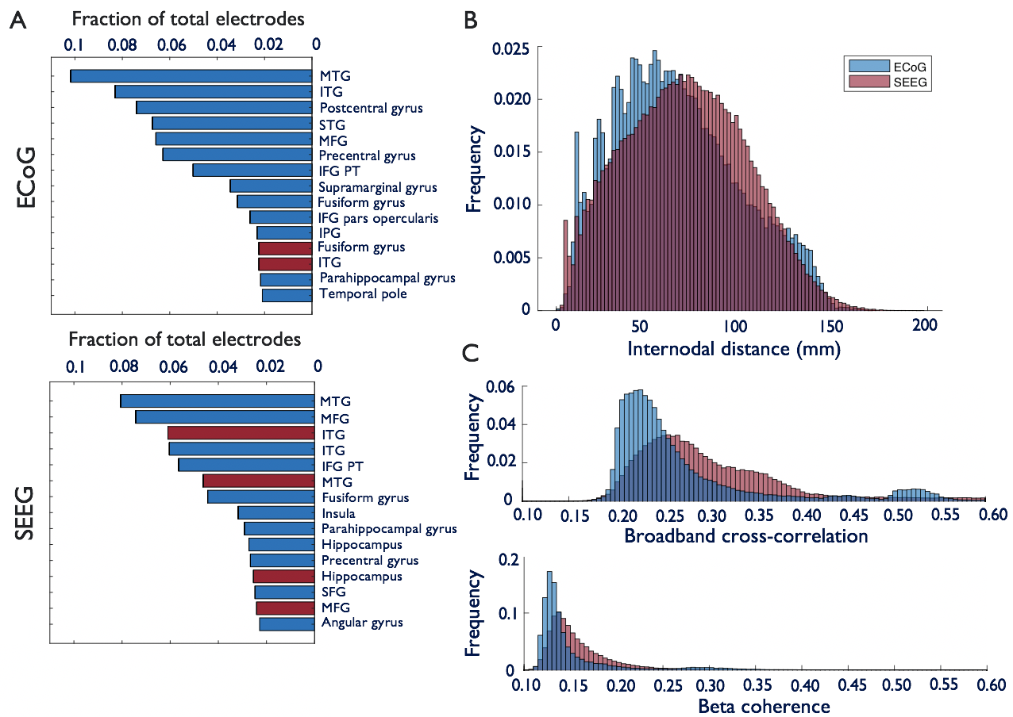
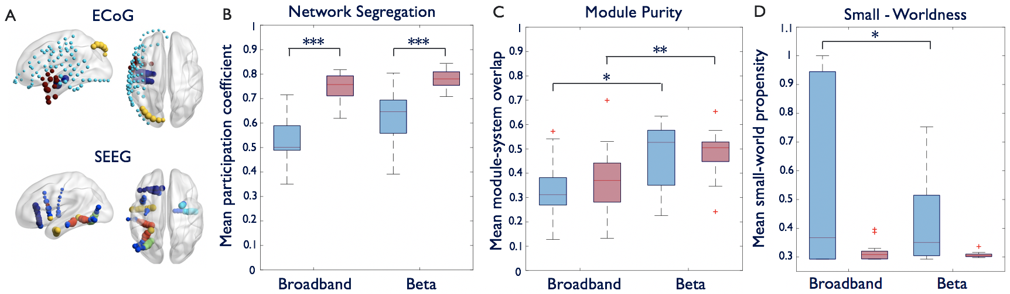
ECoG vs SEEG final figures

Slide 14
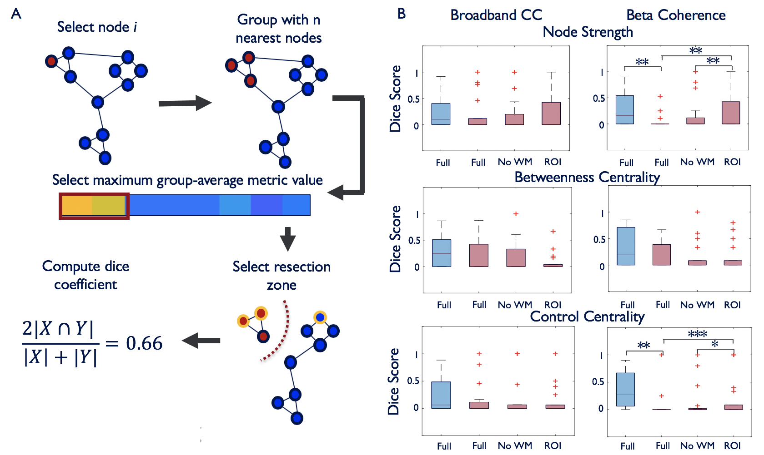

Slide 15
Figure 1 - methods
A
Post-implant MRI
Map to AAL-116
Electrode localization
Electrode | Brain ROI | X | Y | Z
LA1 | Amygdala | -29.14 | 27.42 | -21.65
LA2 | Amygdala | -30.74 | 22.79 | -21.45
LA3 | White Matter | -32.92 | 17.69 | -21.10
… | … | … | … | …
RK10 | Right OpIFG | 51.35 | 21.80 | 32.37
B
Interictal iEEG
Adjacency matrix
1
Channels
Channels
Coherence
0
Time
Channels

Slide 16
Figure 2 – anatomy/distance/connectivity
A
Fraction of total electrodes
B
0.1
0.08
0.06
0.04
0.02
0
0.025
MTG
ITG
0.020
Postcentral gyrus
STG
MFG
0.015
Precentral gyrus
Frequency
ECoG
IFG PT
Supramarginal gyrus
Fusiform gyrus
0.010
IFG pars opercularis
IPG
Fusiform gyrus
0.005
ITG
Parahippocampal gyrus
Temporal pole
C
0
0
200
Fraction of total electrodes
50
100
150
C
Internodal distance (mm)
0.1
0.08
0.06
0.04
0.02
0
MTG
0.06
MFG
0.04
ITG
Frequency
ITG
0.02
IFG PT
MTG
Fusiform gyrus
SEEG
0
Insula
0.55
0.10
0.15
0.20
0.25
0.30
0.35
0.40
0.45
0.50
0.60
Parahippocampal gyrus
Broadband cross-correlation
Hippocampus
0.2
Precentral gyrus
Hippocampus
SFG
MFG
Frequency
Angular gyrus
0.1
0
0.55
0.10
0.15
0.20
0.25
0.30
0.35
0.40
0.45
0.50
0.60
Beta coherence

Slide 17
Figure 2 – anatomy/distance/connectivity
A
Fraction of total electrodes
B
0.1
0.08
0.06
0.04
0.02
0
0.025
***
MTG
ITG
0.020
Postcentral gyrus
STG
MFG
0.015
Precentral gyrus
Frequency
ECoG
IFG PT
Supramarginal gyrus
Fusiform gyrus
0.010
IFG pars opercularis
IPG
Fusiform gyrus
0.005
ITG
Parahippocampal gyrus
Temporal pole
C
0
0
200
Fraction of total electrodes
50
100
150
C
Internodal distance (mm)
0.1
0.08
0.06
0.04
0.02
0
0.18
MTG
0.16
MFG
0.14
ITG
ITG
0.12
***
IFG PT
MTG
Fusiform gyrus
SEEG
0.10
Insula
Parahippocampal gyrus
0.08
Frequency
Hippocampus
Precentral gyrus
0.06
Hippocampus
SFG
0.04
MFG
Angular gyrus
0.02
0.10
0.15
0.20
0.25
0.30
0.35
0.40
Beta coherence

Slide 18
Figure 3 – Mesoscale network structure
A
ECoG
B
Network Integration
C
Module – System Purity
1
1
0.9
***
0.9
0.8
0.8
0.7
0.7
0.6
Mean participation coefficient
SEEG
0.5
0.6
0.4
0.5
0.3
0.2
0.4
0.1
0.3
0
ECoG
SEEG
ECoG
SEEG

Slide 19
Figure 4 – Relation to epileptogenic zone
A
Node Strength
B
Betweenness Centrality
C
Control Centrality
2
***
1.5
*
*
3
1
1
2
*
Metric Z-score
Broadband CC
0
0.5
1
-1
0
0
-2
NR
R
NR
R
NR
R
NR
R
NR
R
NR
R
***
**
2
***
*
1.5
3
1
1
2
Beta Coherence
Metric Z-score
***
0
0.5
1
-1
0
0
-2
NR
R
NR
R
NR
R
NR
R
NR
R
NR
R

Slide 20
Figure 4 – Relation to epileptogenic zone
A
Node Strength
B
Betweenness Centrality
***
2
***
1.5
1
1
Metric Z-score
***
0
0.5
-1
0
-2
NR
R
NR
R
NR
R
NR
R
***

Slide 21
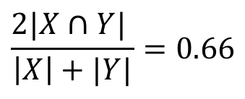
Figure 5 – Epileptogenic zone localization
A
Group with n nearest nodes
B
Broadband CC
Beta Coherence
Select node i
Node Strength
**
**
**
1
1
Dice Score
0.5
0.5
0
0
Full
Full
No WM
ROI
Full
Full
No WM
ROI
Select maximum group-average metric value
Betweenness Centrality
1
1
Dice Score
0.5
0.5
Compute dice coefficient
Select resection zone
0
0
Full
Full
No WM
ROI
Full
Full
No WM
ROI
Control Centrality
$$\frac{2|X∩Y| }{\left|X\right|+|Y|}=0.66$$
***
**
*
1
1
Dice Score
0.5
0.5
0
0
Full
Full
No WM
ROI
Full
Full
No WM
ROI

Slide 22
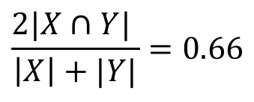
Figure 5 – Epileptogenic zone localization
A
Group with n nearest nodes
B
Node Strength
Select node i
1.4
*
***
1.2
**
*
1
0.8
Dice Score
0.6
0.4
0.2
Select max/min group-average metric value
0
-0.2
Full
Full
No WM
ROI
Betweenness Centrality
Compute dice coefficient
Select resection zone
1.4
*
1.2
*
1
0.8
$$\frac{2|X∩Y| }{\left|X\right|+|Y|}=0.66$$
Dice Score
0.6
0.4
0.2
0
-0.2
Full
Full
No WM
ROI

Slide 23
*
***
*
**
*
*
*

